Slide 1
Portfolio Presentation
Lexus Macalalad

Slide 2
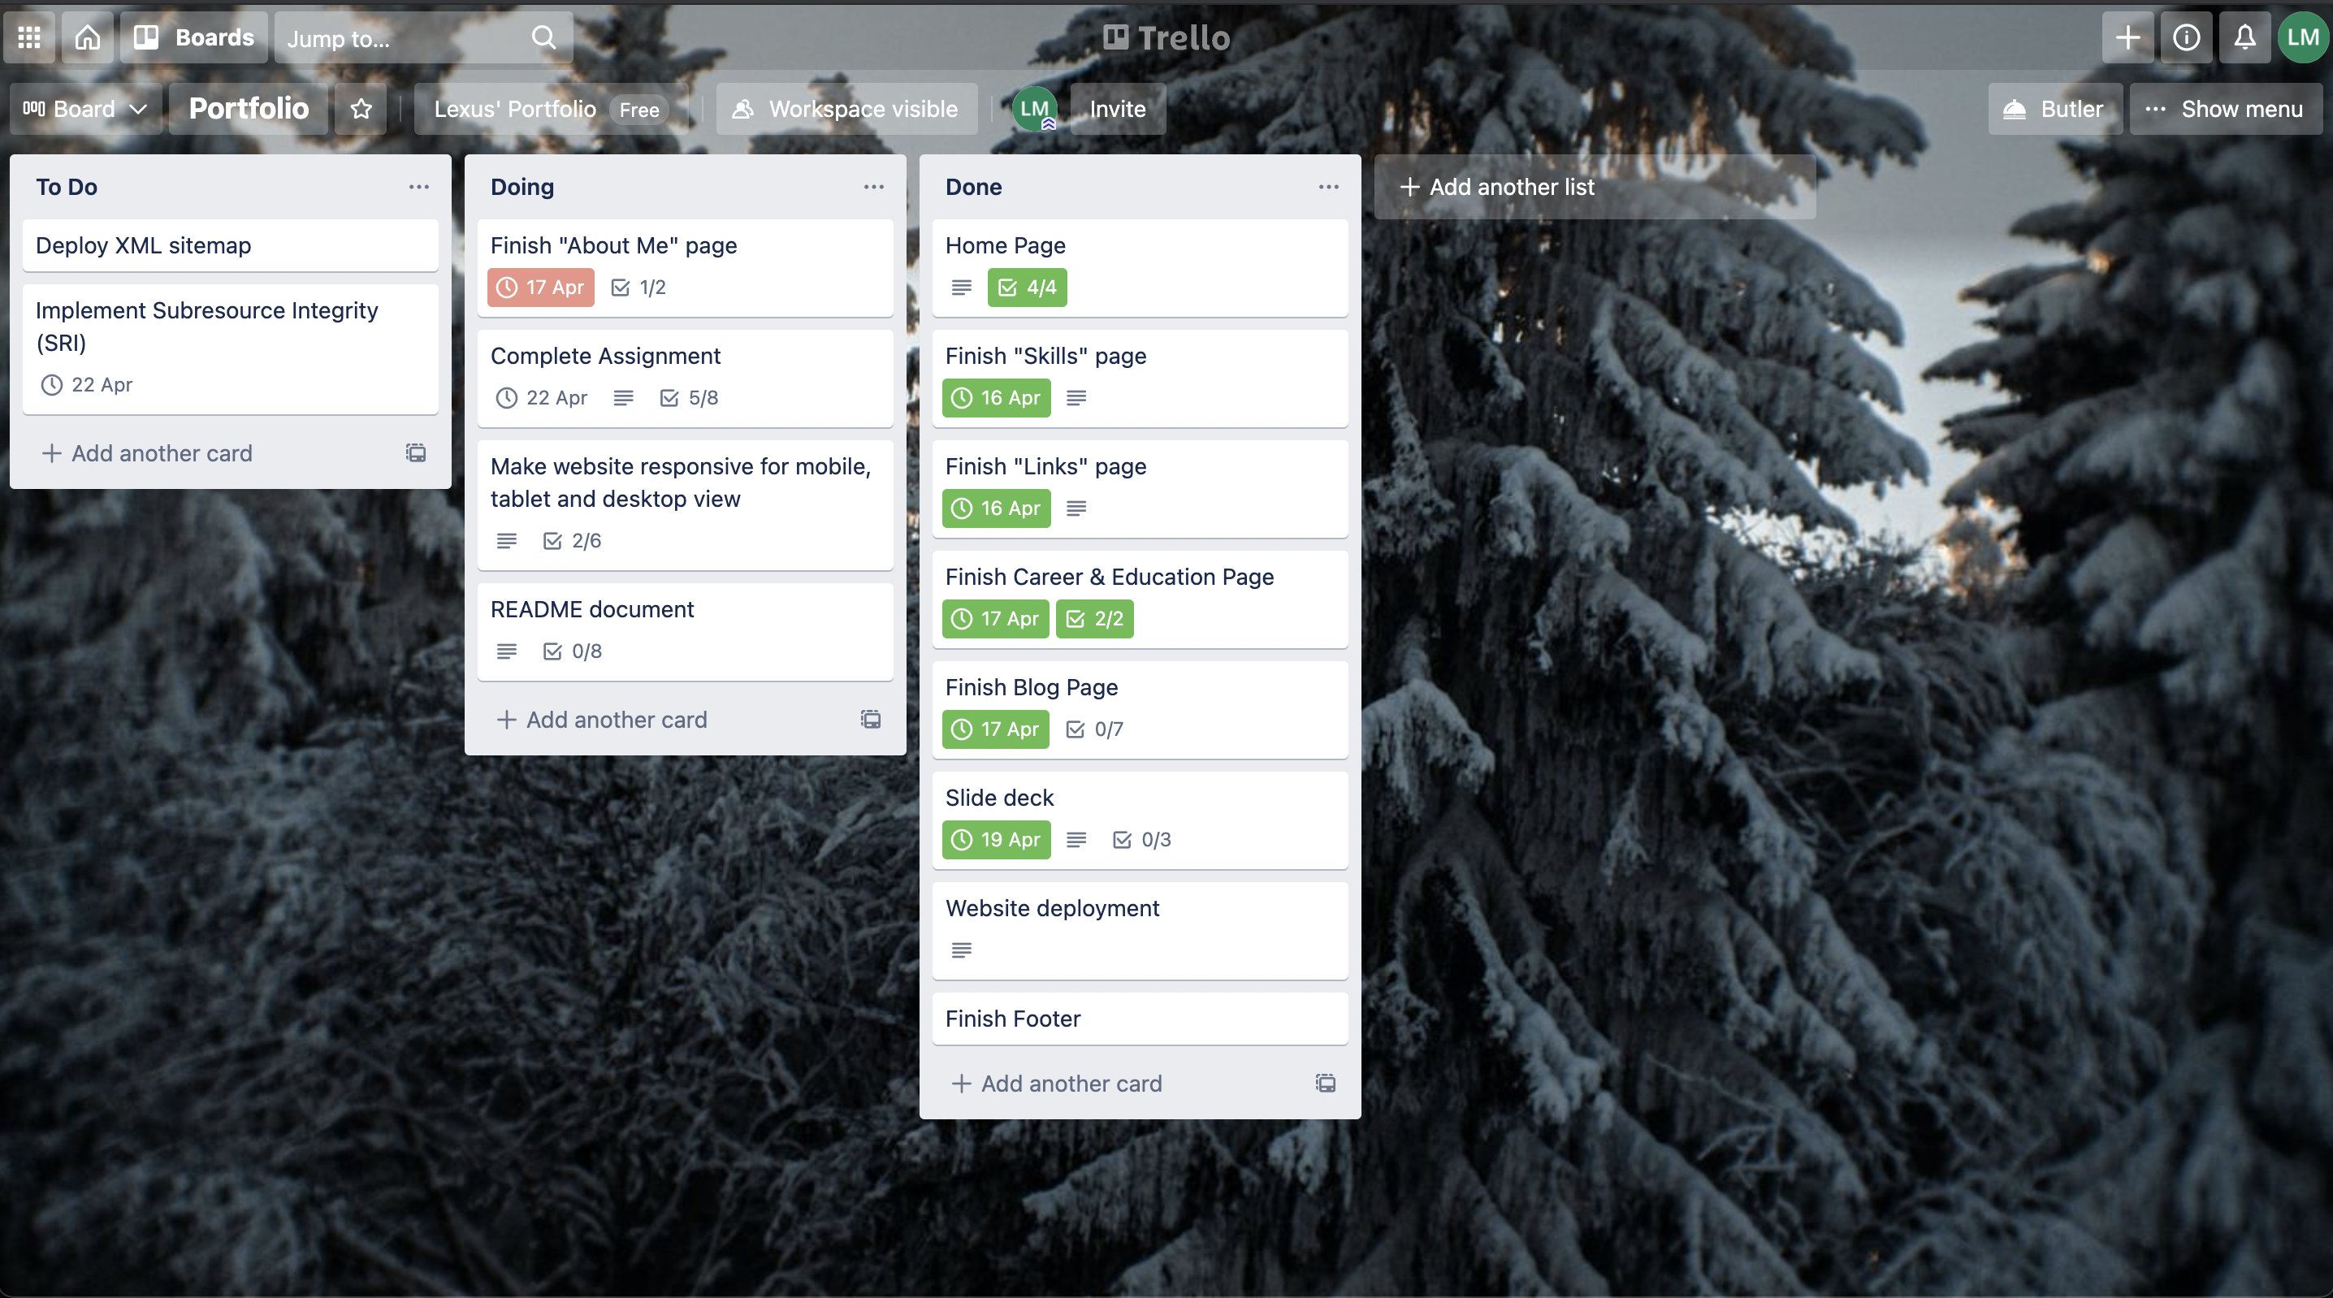
Keeping Track of Progress

Slide 3

Design Process
Sitemaps
Colour Palette
Wireframes

Slide 4
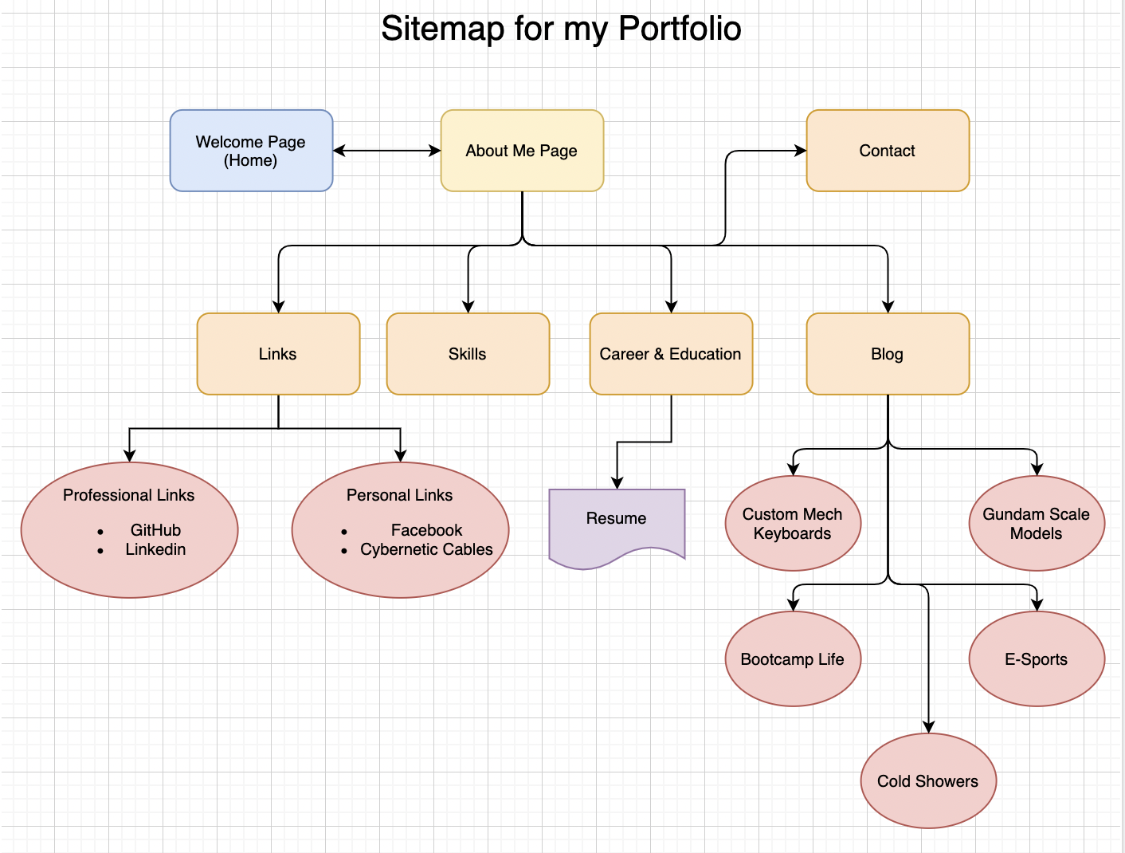
Sitemap

Slide 5
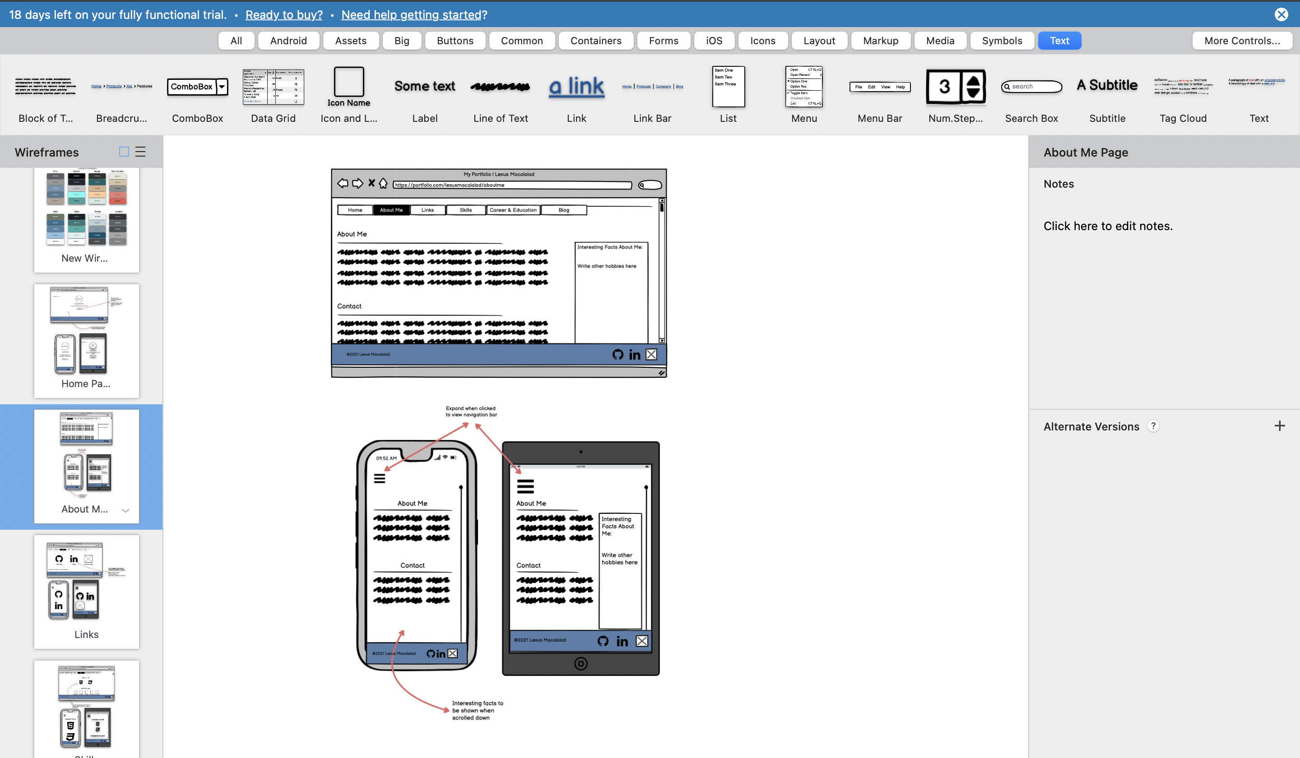
Wireframes

Slide 6
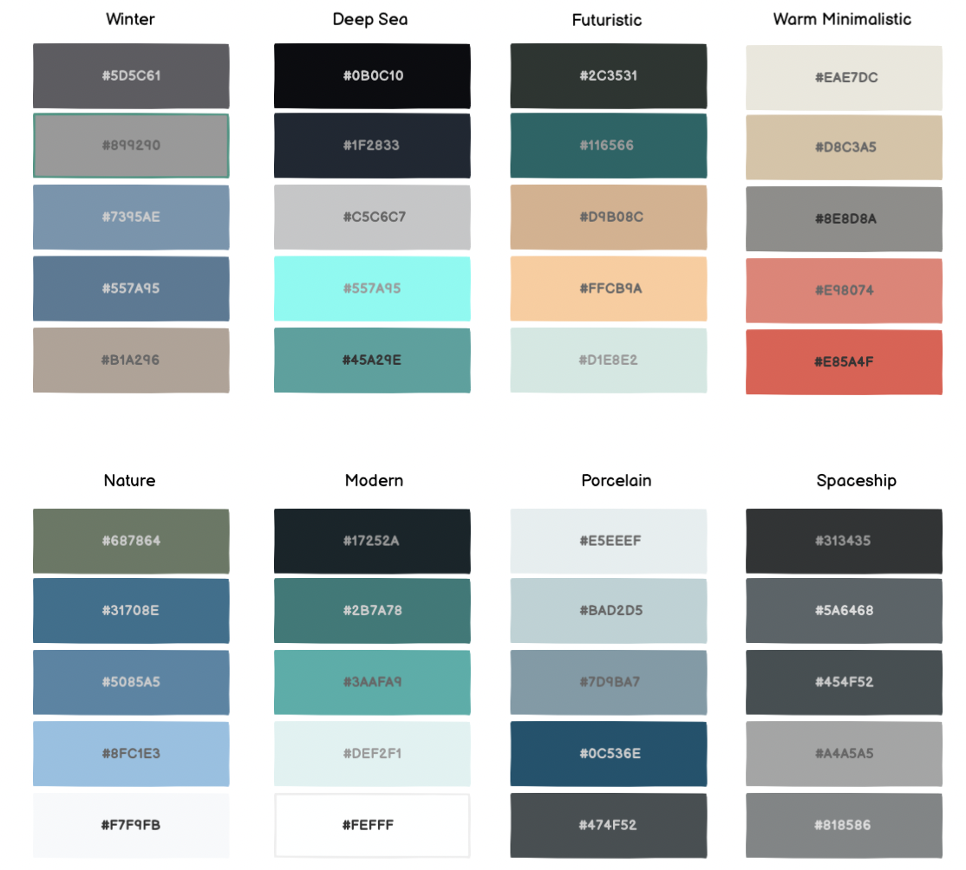
Colour Palettes

Slide 7
Components Used
Navigation bar
Elements with animation
Minimal colours

Slide 8
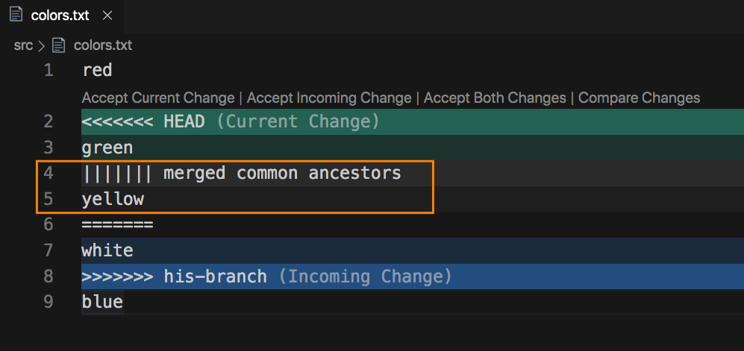
Challenges/Roadblocks
Git Conflicts
Element positioning
Margin
Flexbox

Slide 9
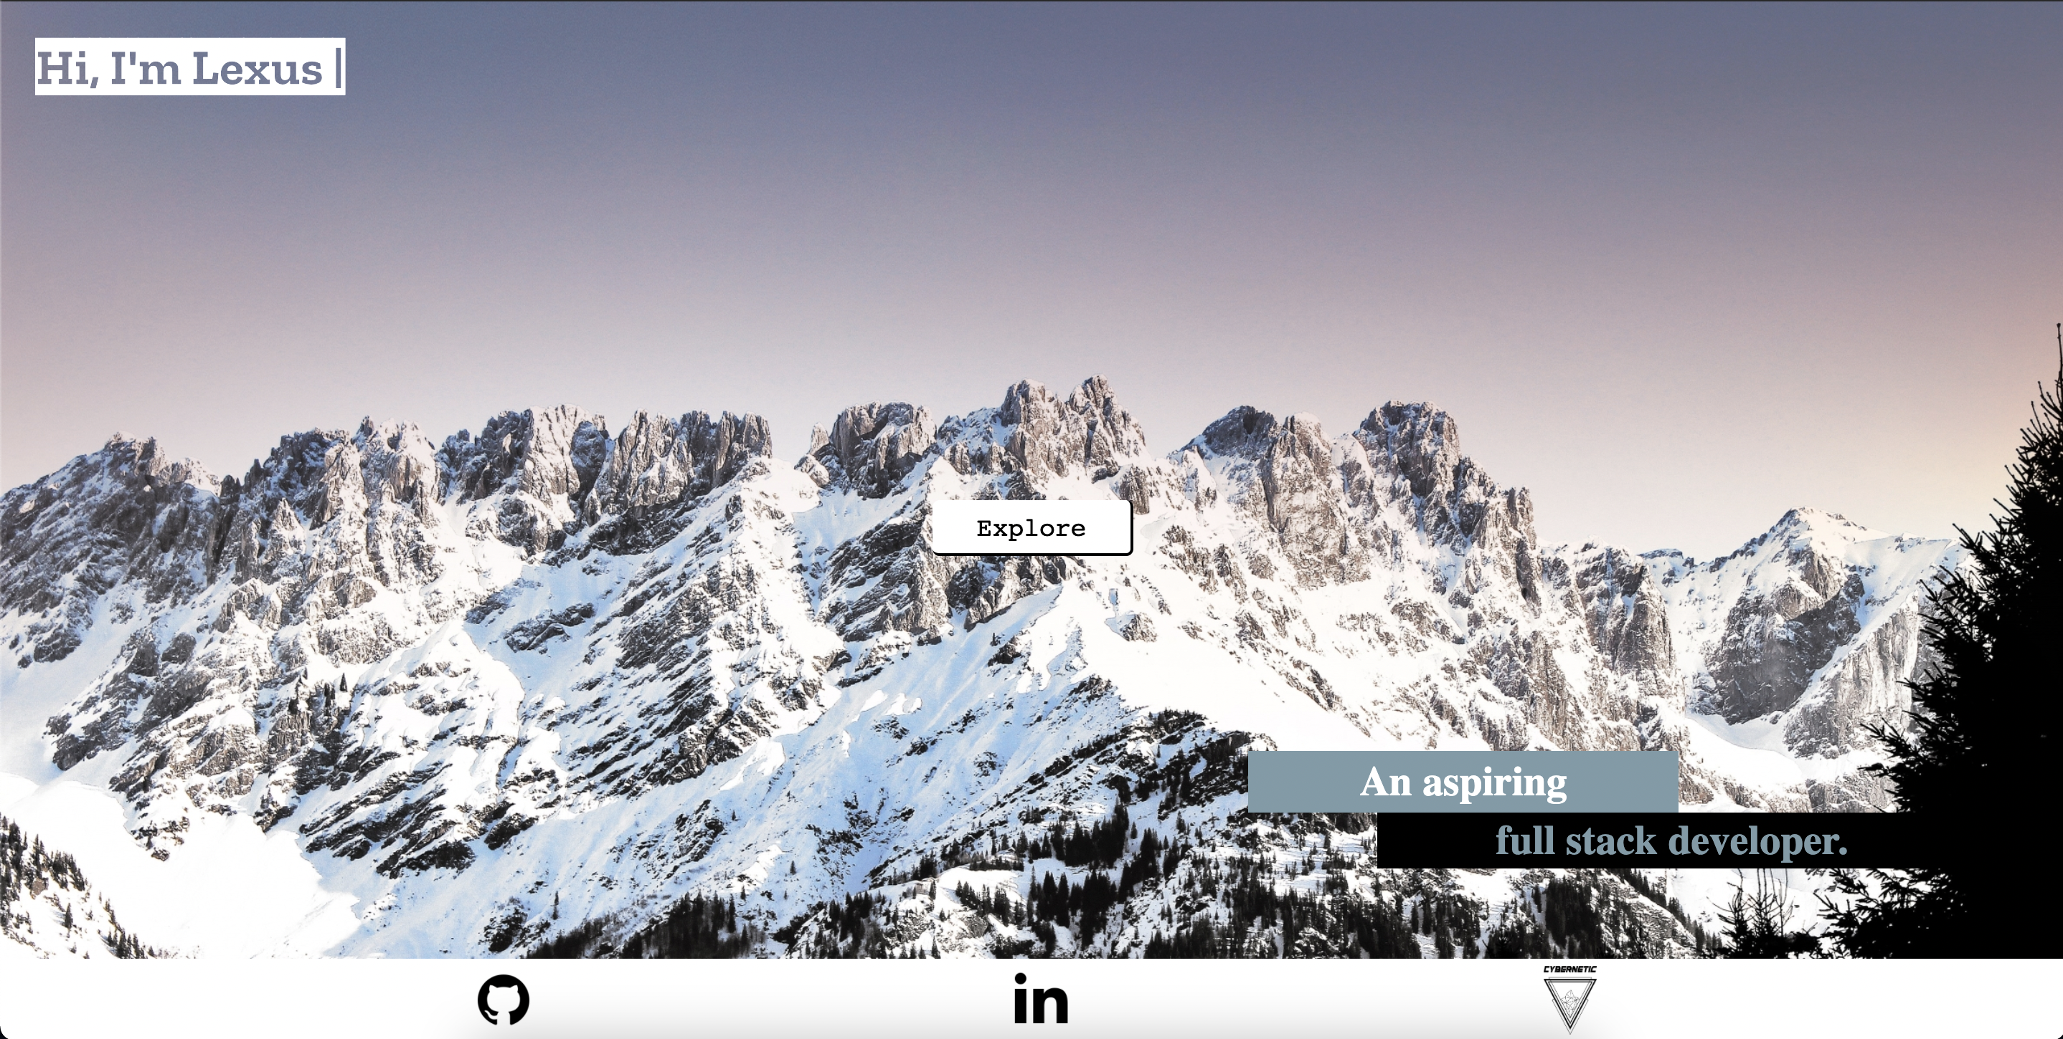

Favourite Parts
Getting the code to work
Learning process

Slide 10
Reflections
Skill level
Growth Mindset
Don’t be afraid to ask for help

